Slide 1
2012-2017 Parks and Recreation Comprehensive Plan Update
Survey Results

Slide 2
In June 2011, 4,300 survey’s were mailed to random City of Yakima residents
The survey was 4 pages long and contained a variety of questions dealing with park usage, media, park facilities, recreation programs, customer service, future planning, and demographic/background information.
The survey was provided in English and Spanish.
Included in the mailer were: 1 coupon for a free swim (for up to 5 people) and 1 coupon good for $2 off a round of golf at Fisher (for up to 4 people).
868 surveys were mailed back and tabulated (20.1% return).
In addition to the random mailer, the survey was available for pickup, printout on the city website, and to take online with Survey Monkey.
354 people took the survey online with Survey Monkey, and an additional 70 were filled out and brought in.
The total survey return was 1,292.

Slide 3
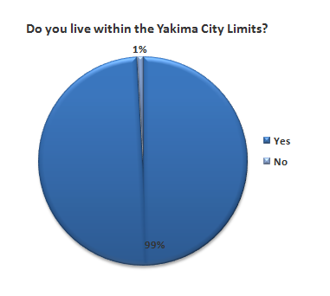
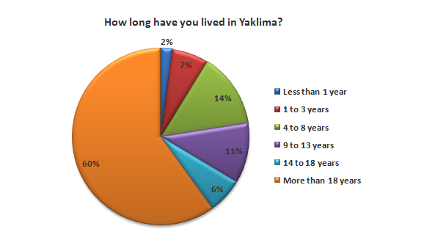
Background Information

Slide 4
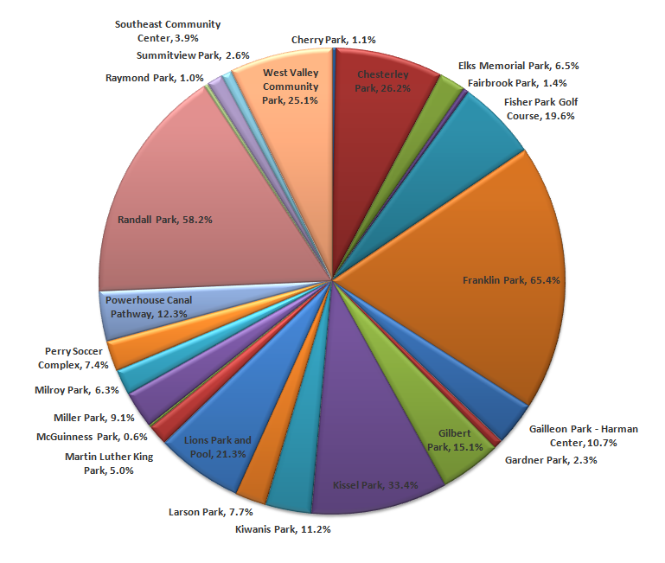
Park Usage
Which Yakima City Parks do you visit regularly?
Top 3:
Franklin Park – 65.4%
Randall Park – 58.2%
Kissel Park – 33.4%

Slide 5
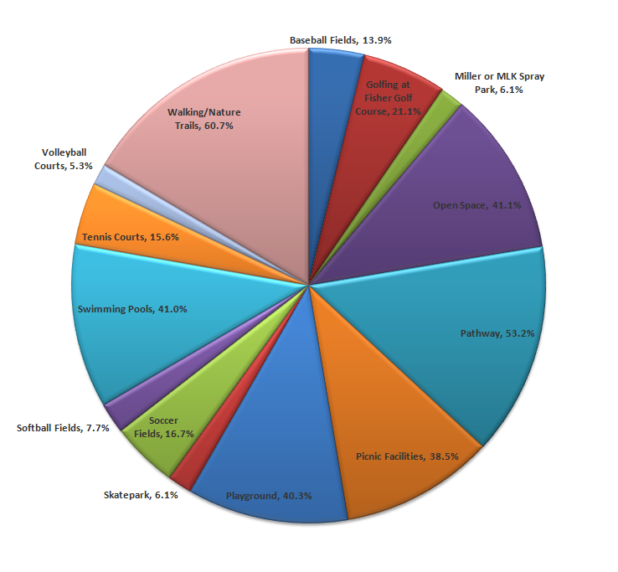
Park Usage
What type of park and recreation amenities do you and your family use the most?
Top 3:
Walking/Nature Trails – 60.7%
Pathway – 53.2%
Open Space – 41.1%

Slide 6
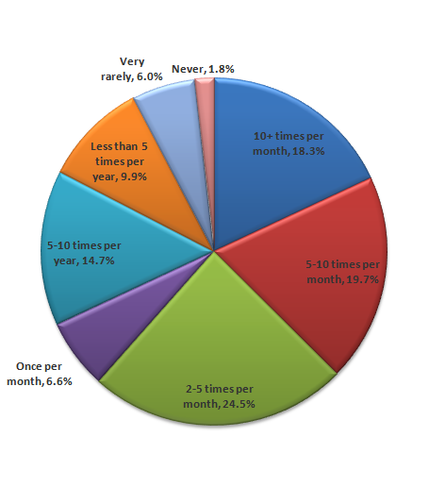
Park Usage
On average, how often do you visit parks?

Slide 7
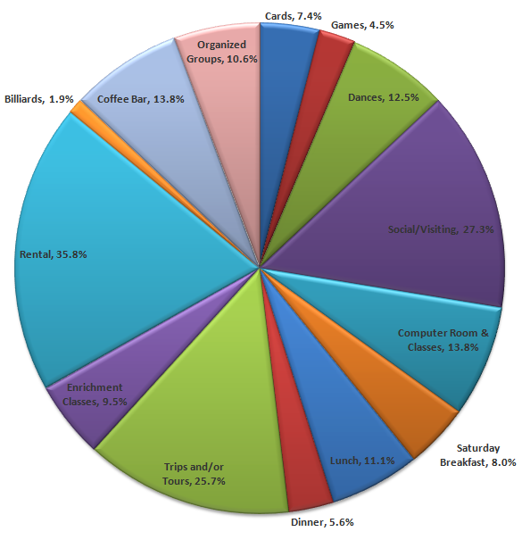
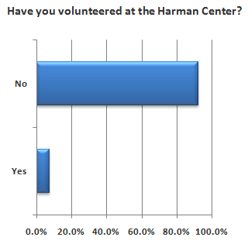
Park Usage ~ Harman Center
Harman Center usage/participation

Slide 8
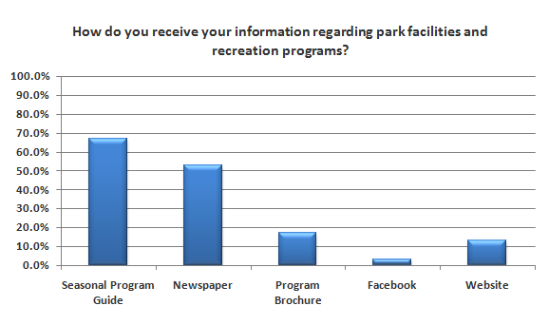
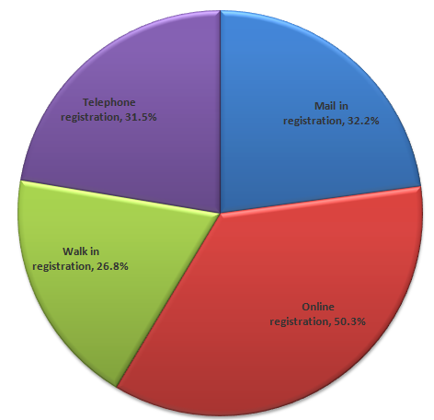
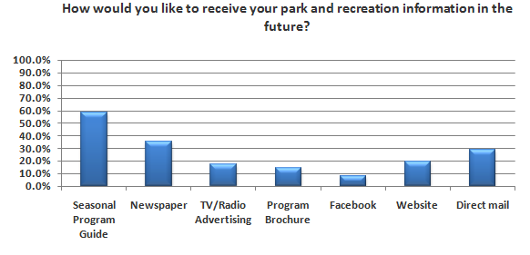
Media Questions
What method do you prefer for the registration of park programs and facility rentals?

Slide 9
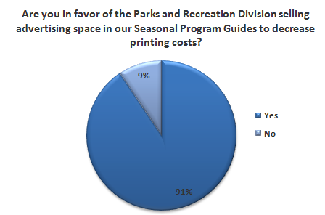
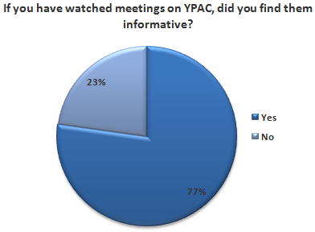
Media Questions

Slide 10
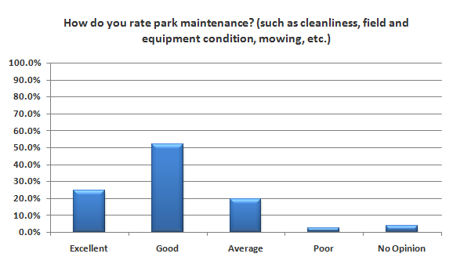
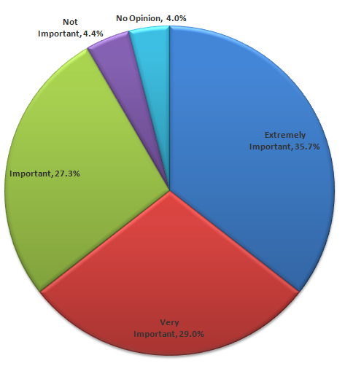
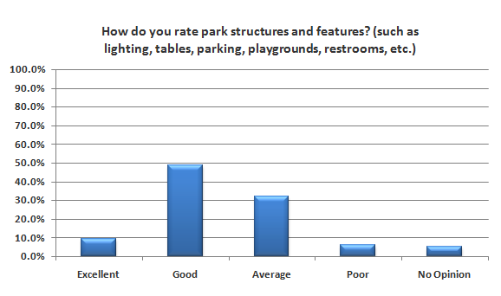
Parks Facility Opinion Questions
How important are City Parks and Recreation Facilities to you and your family?

Slide 11
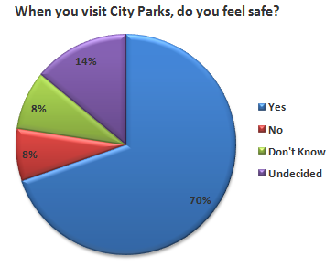
Parks Facility Opinion Questions
Of the Yes answers, there were a number of
residents who qualified their ‘Yes’ answer with saying
that it is dependent on the Park and the Time of Day.

Slide 12
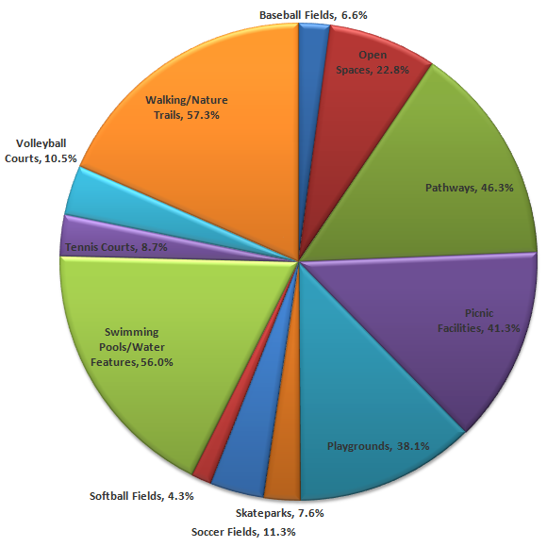
Parks Facility Opinion Questions
What Parks and Recreation Amenities would you like to see more of?
Top 3:
Walking/Nature Trails – 57.3%
Swimming Pools/Water Features – 56.0%
Pathways – 46.3%

Slide 13
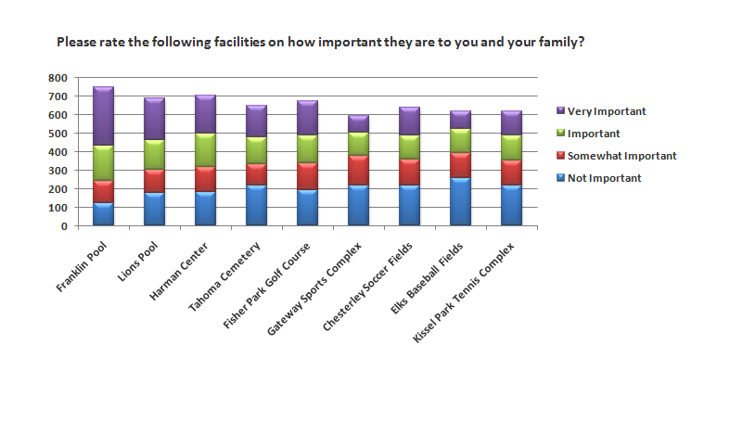
Parks Facility Opinion Questions

Slide 14
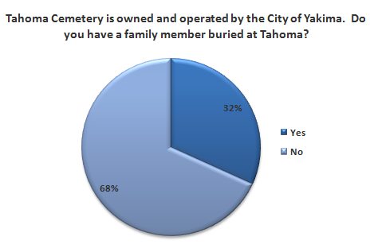
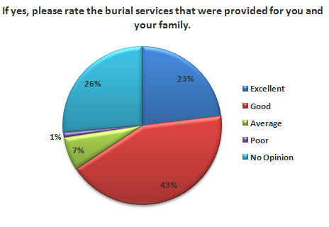
Parks Facility Opinion Questions

Slide 15
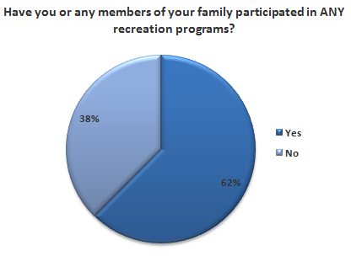
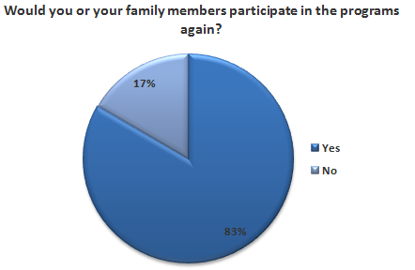
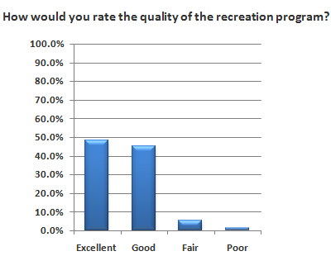
Recreation Program Questions

Slide 16
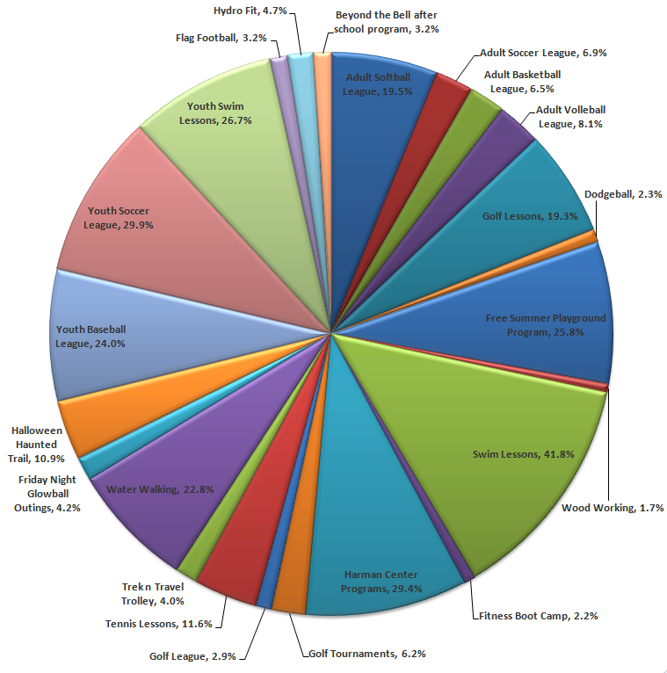
Recreation Program Questions
Which Recreation Programs have you or your family participated in?
Top 3:
Swim Lessons – 41.8%
Youth Soccer League – 29.9%
Harman Center Programs – 29.4%

Slide 17
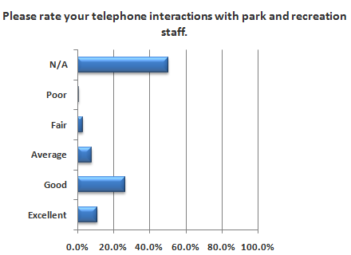
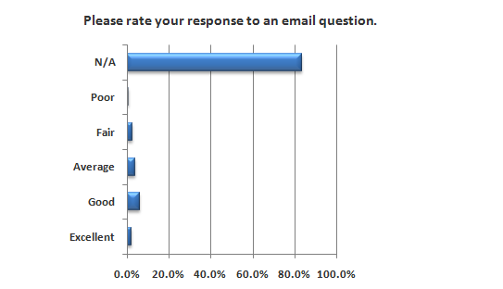
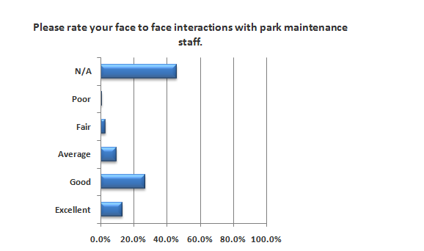
Customer Service

Slide 18
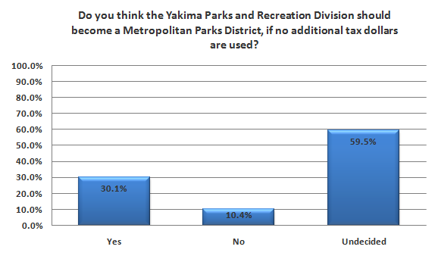
Future Planning Questions

Slide 19
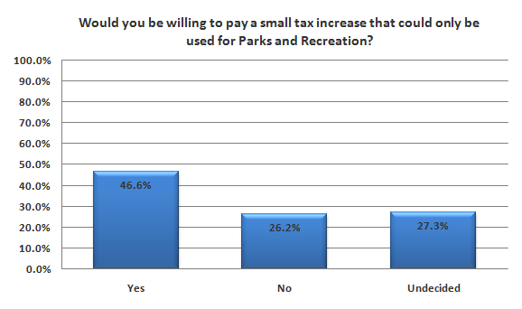
Future Planning Questions

Slide 20
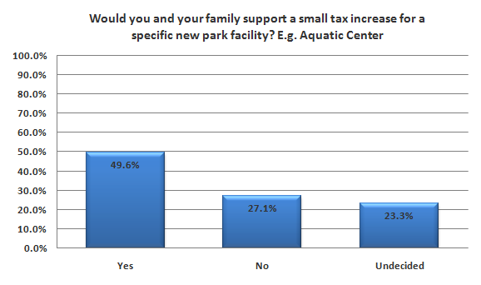
Future Planning Questions

Slide 21
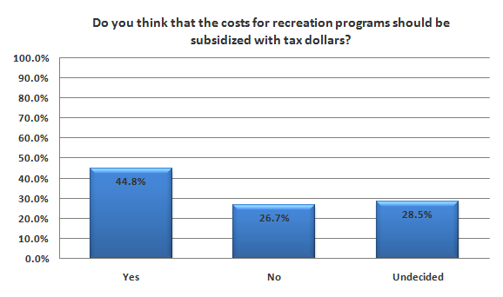
Future Planning Questions

Slide 22
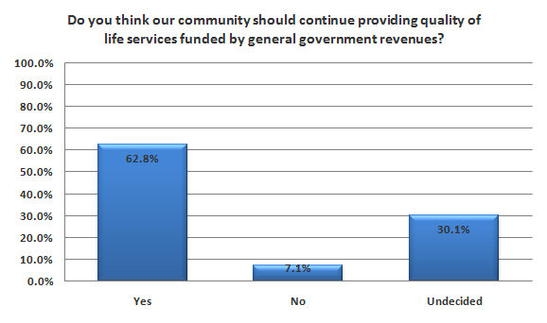
Future Planning Questions

Slide 23
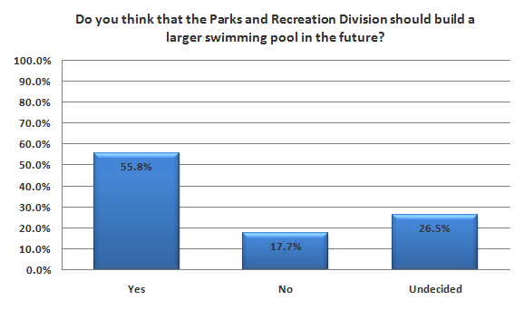
Future Planning Questions

Slide 24
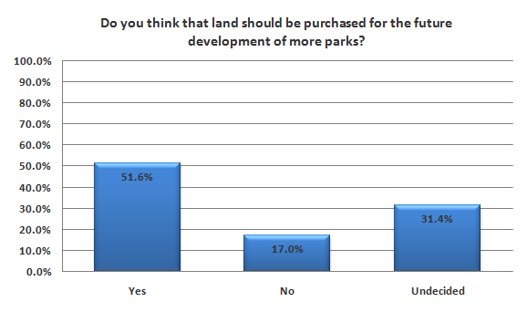
Future Planning Questions

Slide 25
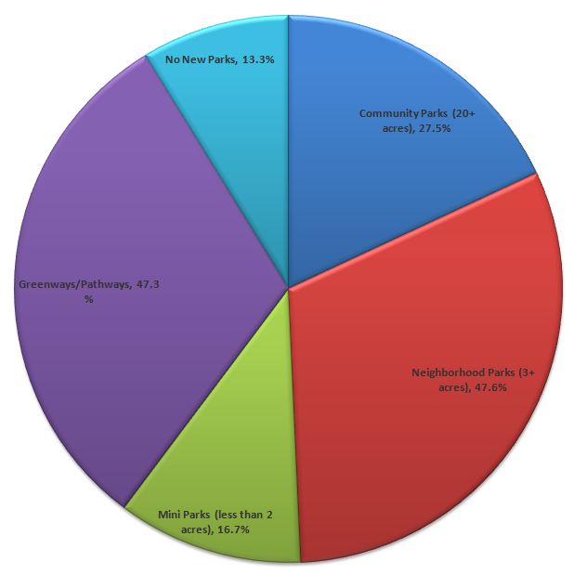
Future Planning Questions
What kinds of new parks should be developed?

Slide 26
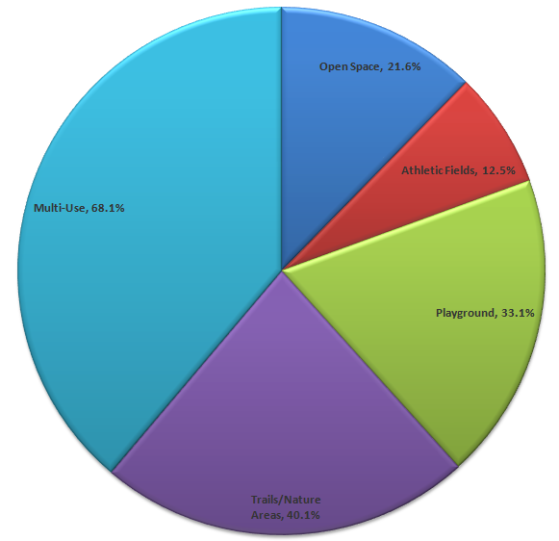
Future Planning Questions
How should new parks be developed?

Slide 27
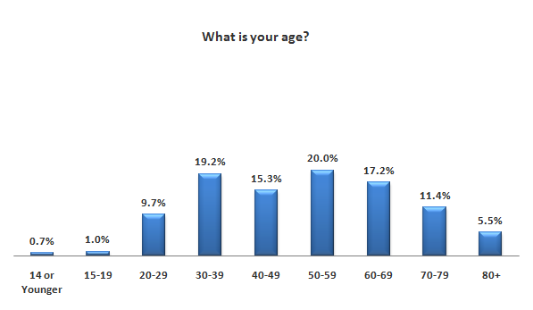
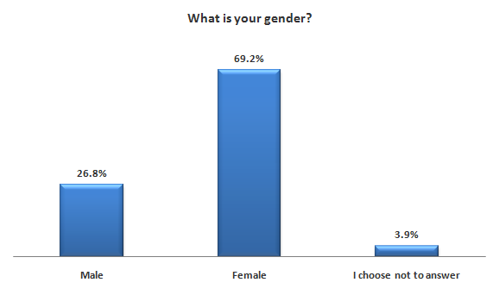
Demographic Information

Slide 28
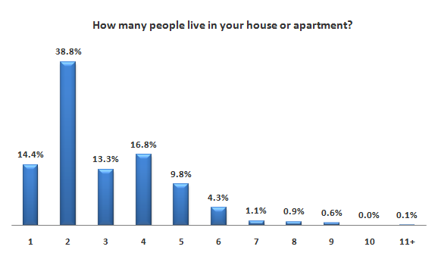
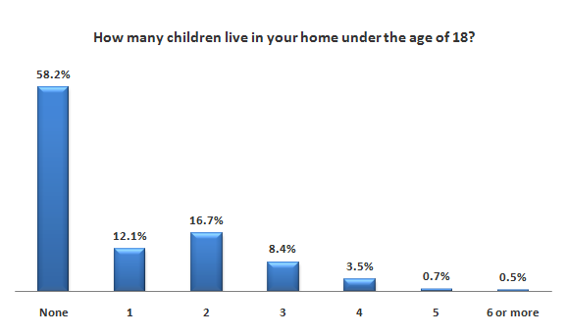
Demographic Information

Slide 29
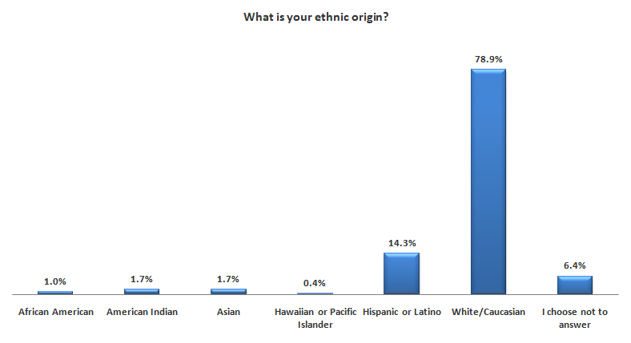
Demographic Information

Slide 30
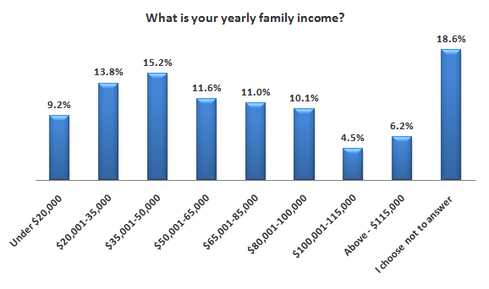
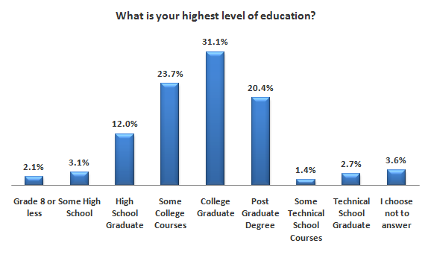
Demographic Information

Slide 31
Additional Information
The final question on the survey was a request for additional information from citizens.
There were 279 responses submitted.
Responses were mostly positive, however there were several valid points made which will help us improve parks in the future.

